Slide 1
HTML5 –Images on canvas

Slide 2

HTML5
We can set up style for the canvas background:
<canvas id="myCanvas" width="600" height="400"
style="background-imag
e:url('sky.png');"></canvas>

Slide 3
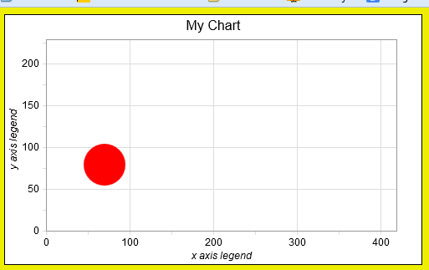
Good use for background http://www.codeproject.com/Articles/221180/HTML-Canvas-Self-drawn-Persistent-Background

Slide 4
We can add image to canvas as well
<script>
var canvas = document.getElementById('myCanvas');
var context = canvas.getContext('2d');
var myImg = new Image();
myImg.onload = function() {
context.drawImage(myImg, 250, 250);
};
myImg.src = 'bird.gif';
</script>

Slide 5
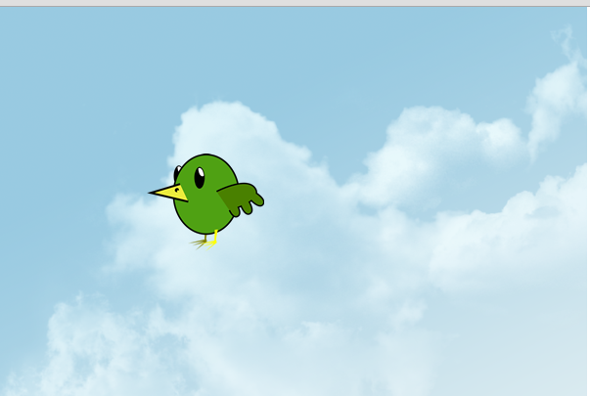
Example

Slide 6
Make more complex:
We can add drawing shapes on top of the image
Add animation on top of the image

Slide 7
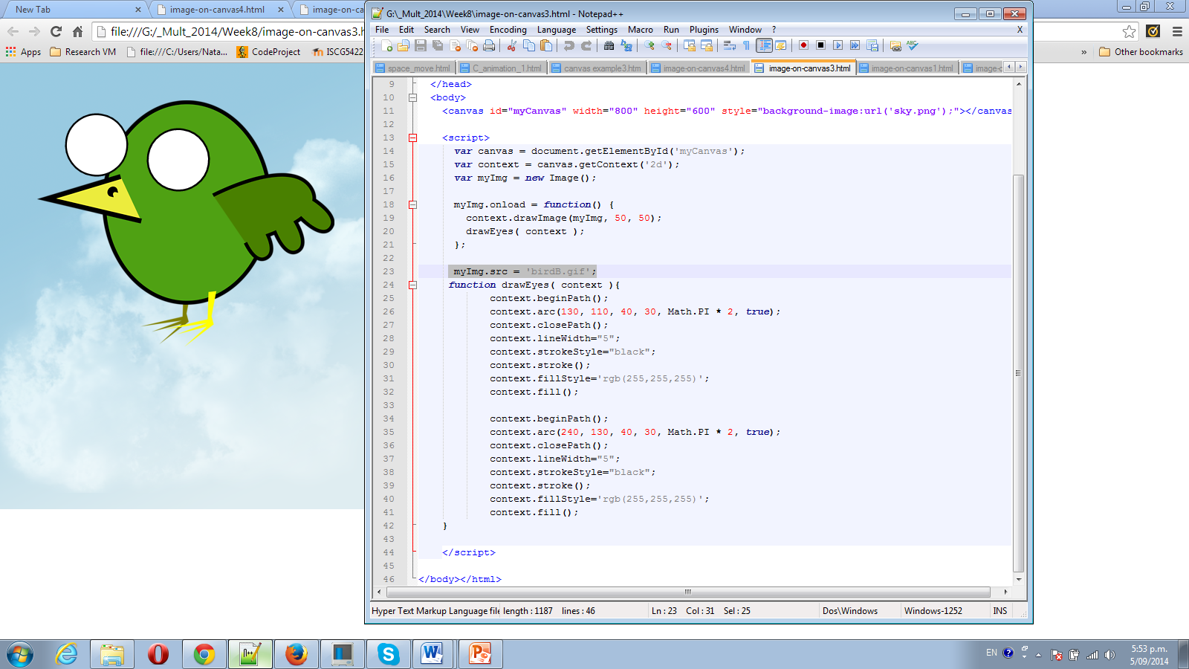

Slide 8
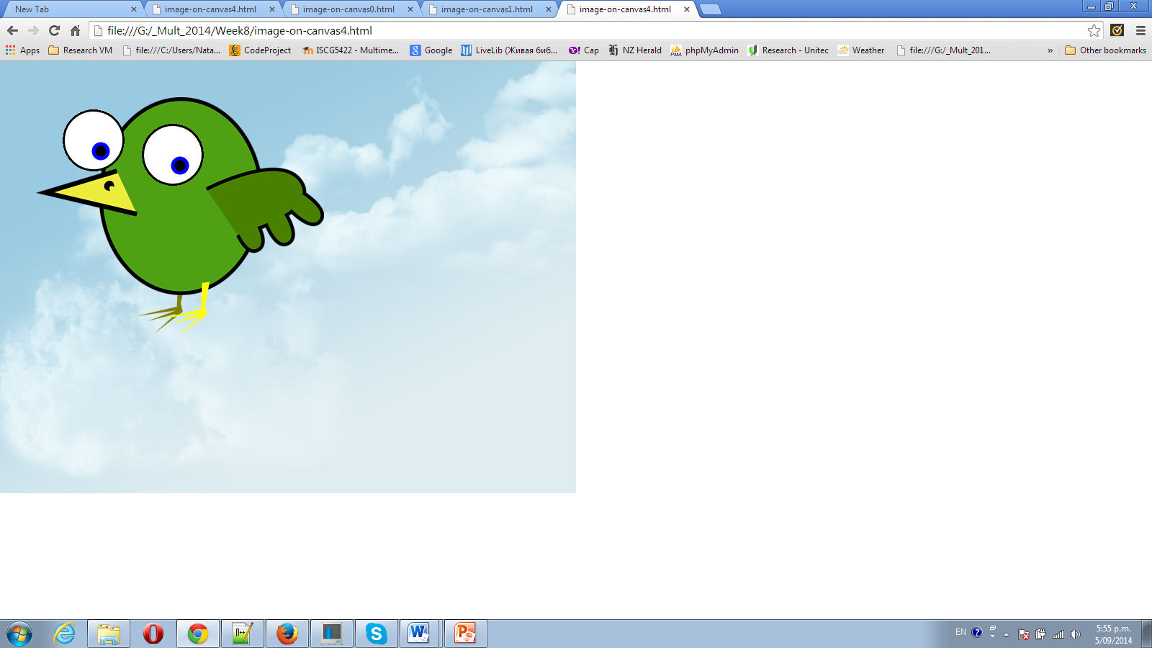

Slide 9
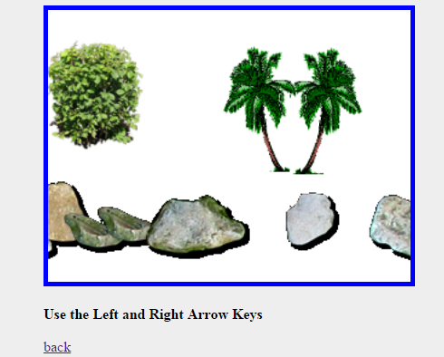
http://www.webbingways.com/bookfiles/chapter14/codelisting_14-10.html

Slide 10
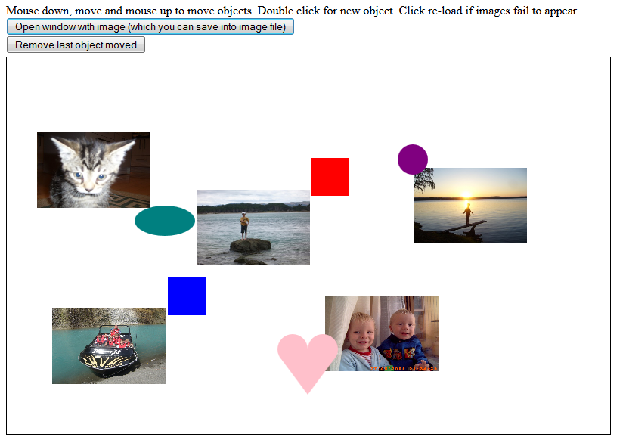
Family Album

Slide 11
Save canvas as image file
http://weworkweplay.com/play/saving-html5-canvas-as-image/
<a href="#" class="button" id="btn-download" download="my-file-name.png">Download</a>
var button = document.getElementById('btn-download');
button.addEventListener('click', function (e) {
var dataURL = canvas.toDataURL('image/png');
button.href = dataURL;
}); // works only on firefox //we can’t save canvas background!

Slide 12
Resources:
http://www.w3schools.com/tags/canvas_drawimage.asp
http://www.html5tutorial.info/html5-canvas-image.php
http://www.html5tutorial.info/html5-canvas-image.php
http://www.webbingways.com/bookfiles/chapter14/codelisting_14-10.html
http://faculty.purchase.edu/jeanine.meyer

